Slide 1



Applied Data Analysis (CS401)
Lecture 14
ADA in action
20 Dec 2023
Robert West
Notes:
2022: 5 minutes too long (13-min break)
2023: 5 minutes too long (12-min break)
========================
Ed announcement:
Dear all,
I'm already excited about tomorrow's lecture, "ADA in action", where I'll take a research project of my own and will explain how all the methods, techniques, and concepts you've learned about in ADA come together to allow you to conduct a research project from start to finish: from getting, to exploring, to visualizing, to modeling, to interpreting the data.
The project ("Postmortem memory of public figures in news and social media") is described in this paper: https://doi.org/10.1073/pnas.2106152118
It's on the topic of how famous people are remembered in news and social media after their death.
I hope to see many of you in person one more time!
Bob

Slide 2
Announcements
Today: last lecture [click here for a famous last lecture]
No lab session this Friday
Homework H2 feedback slightly delayed 🙇 — ETA tomorrow
Final project milestone P3 due on Fri 22 Dec 2023, 23:59
Final exam: Tue 16 Jan 2024, 15:15–18:15
Announcement re: exam protocol, room assignment, etc., to be made in early January (on Ed with email notification)

Slide 3
Give us feedback on this lecture here: https://go.epfl.ch/ada2023-lec14-feedback
What did you (not) like about this lecture?
What was (not) well explained?
On what would you like more (fewer) details?
…

Slide 4
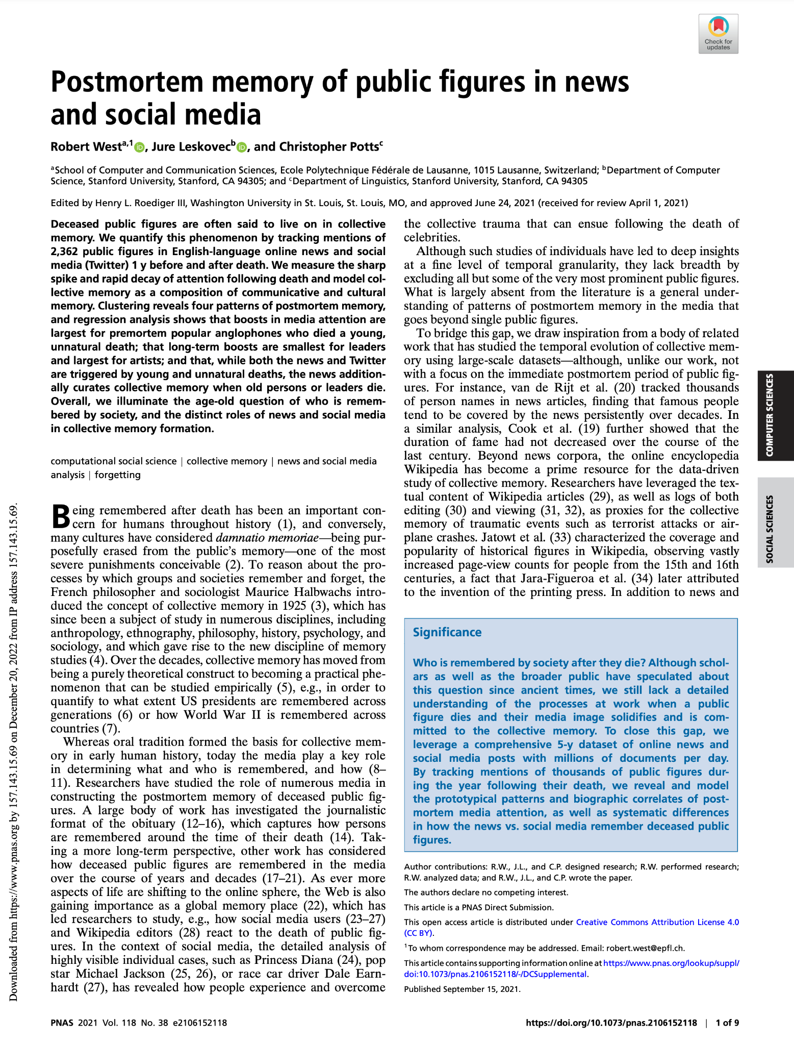
Today I will
present a research paper of mine,
highlight how everything you’ve learned in lectures 1–13 comes together in one project.
Paper available at https://doi.org/10.1073/pnas.2106152118

Slide 5
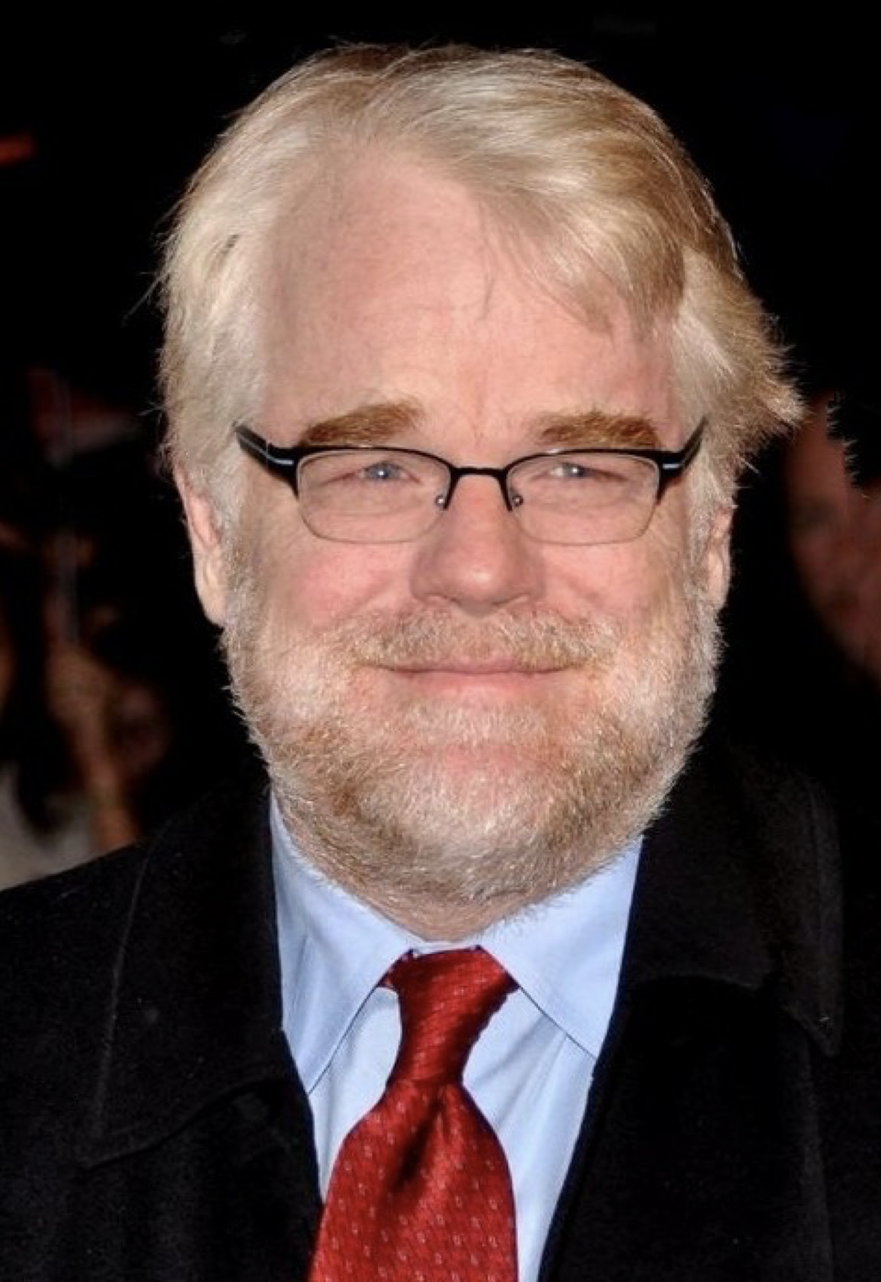
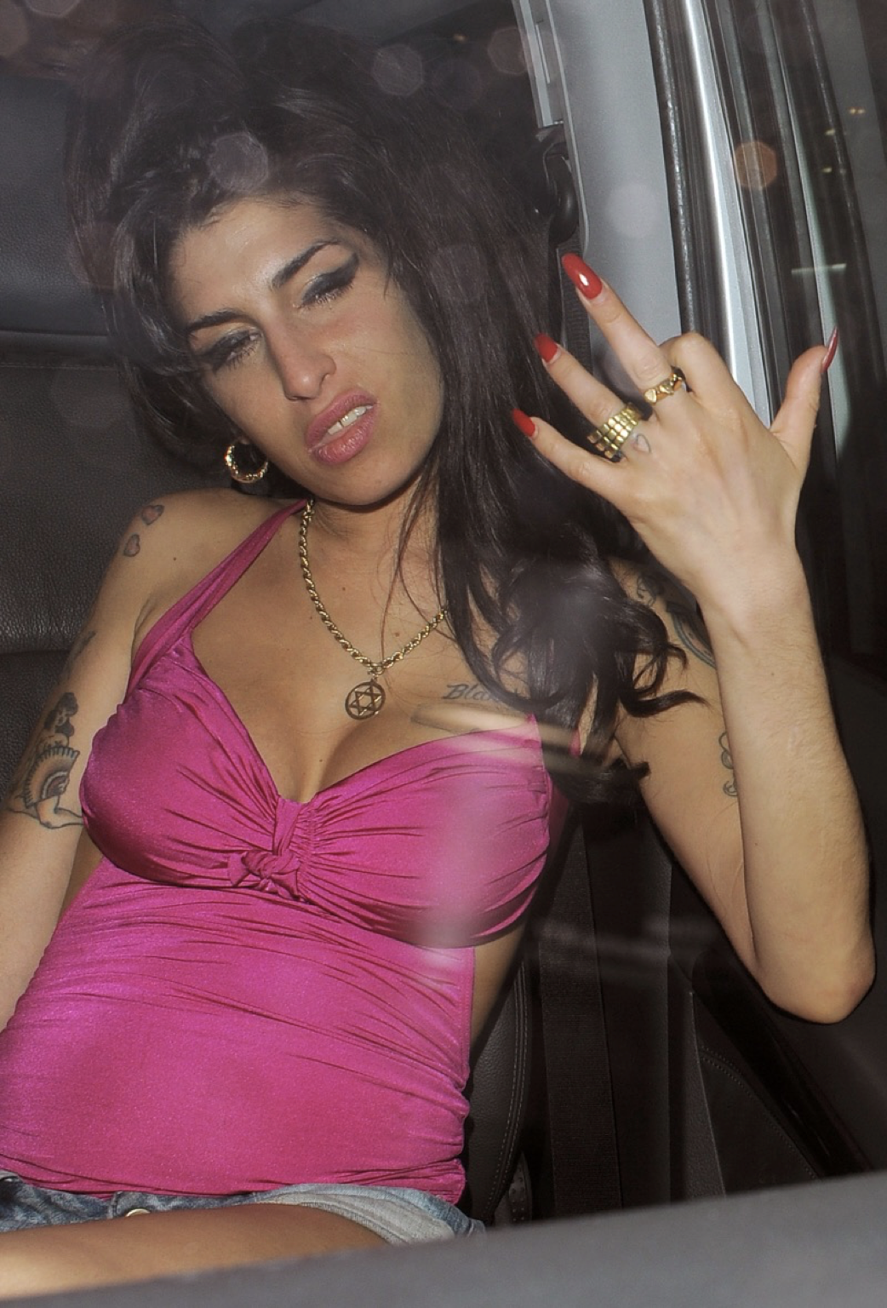
Philip Seymour Hoffman † 2014
Amy Winehouse † 2011
Notes:
My personal starting point: Philip Seymour Hoffman’s death (2 Feb 2014)
Drug overdose (heroine, cocaine, etc.)
But public reaction seemed respectful of the dead, focusing on his lifetime achievements
Made me think back at Amy Winehouse’s death (23 Jul 2011)
Also drug overdose (alcohol)
But here, public reaction much nastier, focusing a lot on her lifetime escapades
What made the difference?
Actor vs. singer?
20 years age diff at death?
Hoffman popular w/ more mature crowd?
His addiction less public?
Personal story how research started no necessarily what you describe in a research paper…
Next: more official story

Slide 6

Questions
Who is remembered by society after death?
“Postmortem collective memory”
Are there prototypical patterns of postmortem collective memory?
Are certain kinds of people remembered in certain ways?
Are dead people remembered differently in news vs. social media?
#6 Observational studies
Notes:
#6 essentially one big obs study: cannot do it experimentally…

Slide 7

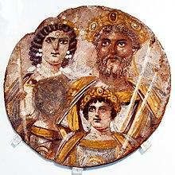
Why should we care about postmortem collective memory?
Fact: Humans care a lot about being remembered after death
Ara Pacis, Rome
[Wikipedia]
Damnatio memoriae [Wikipedia]
Notes:
Ara pacis: people (here Augustus) try hard to be remembered
Conversely, being erased from memory considered as harshest possible punishment by numerous cultures
Right image: “The face of one of Severus' and Julia's sons has been erased; it may be Geta's, as a result of the damnatio memoriae ordered by his brother Caracalla after Geta's death.”
So understanding whom societies remember is an important piece of the puzzle if we want to understand how humanity ticks
Previously mostly in the realm of anthropology, ethnography, philosophy, history, psychology, and sociology
But we’re taking a different approach … [p.t.o.]

Slide 8

An ADA approach
Let’s use lots of data and count stuff!
Detect names of dead people in big corpus of news and social media
Build time series of name counts
Analyze the shape of time series
Correlate shapes with biographic info about dead people from knowledge base
Stuffed Count von Count counting stuff

Slide 9
Part 1:
Getting the data

Slide 10

The raw data:
“Spinn3r provides APIs for social media, weblogs, news, video, and live web content to our customers in any language and in large volumes.” (Source: spinn3r.com)
Firehose stored to disk for over 5 years
Several billions of documents
40 terabytes
#13 Scaling to
massive data
Notes:
…
Reminder: we’re interested in analyzing news and social media
Only part of Spinn3r – there’s much additional stuff
Challenge: how to detect news and social media in Spinn3r?
(Spinn3r doesn’t give us such labels, everything just a webpage)

Slide 11


Detecting news and social media in Spinn3r
Found a list of all 151K online news articles about Osama bin Laden’s killing (2 May 2011) indexed by Google News
Assume that every relevant news outlet had reported on bin Laden’s death, and that Google News is reasonably complete
News defined as documents from the 6,608 Web domains appearing in the “bin Laden list”
Detect via URL pattern: e.g., https://twitter.com/UserName/status/1605097142552403968
#2 Handling data
Notes:
Consider only one social media platform: Twitter
Easy to recognize via URL pattern
…
#2: Finding and filtering the right dataset, cleverly combining datasets

Slide 12
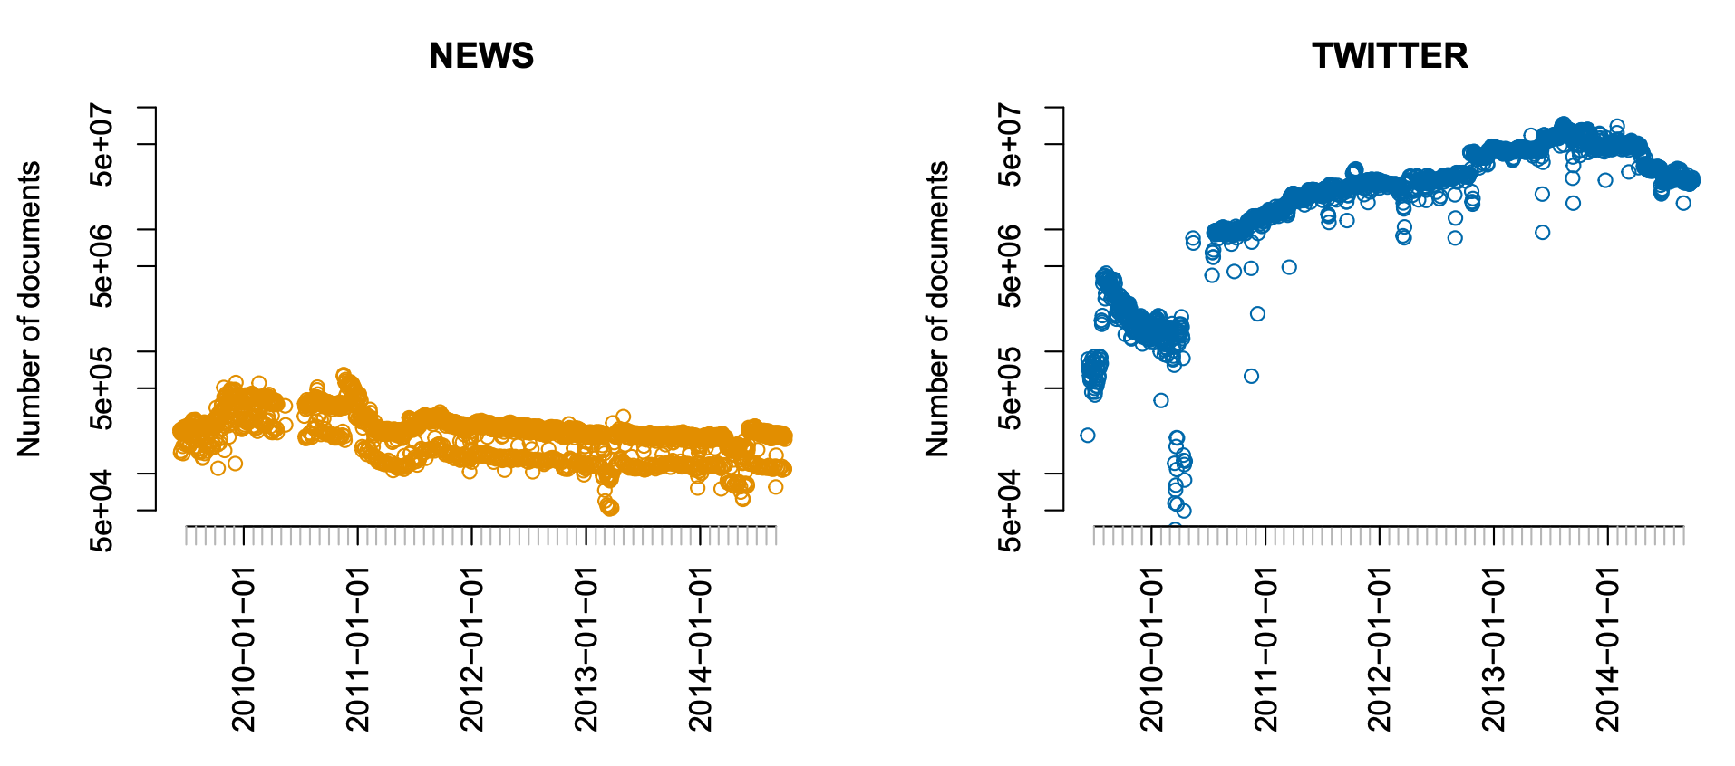
Data volume: Number of docs per day
#3 Visualizing data
Notes:
News: O(100k) per day; Twitter: O(10M) per day
News: weekdays, weekends; not on Twitter
Nonconstant curves/jumps: Spinn3rs crawling algos change (but also more tweets…)
#3 point out colors: blue/yellow, same throughout paper/pres; and colorblind-friendly
#3 same axis left and right
#3 log y-scale (allows us to still see everything despite different oom)
#3 data outage in 2010; visible via dots instead of lines (same for week days, weekends)

Slide 13
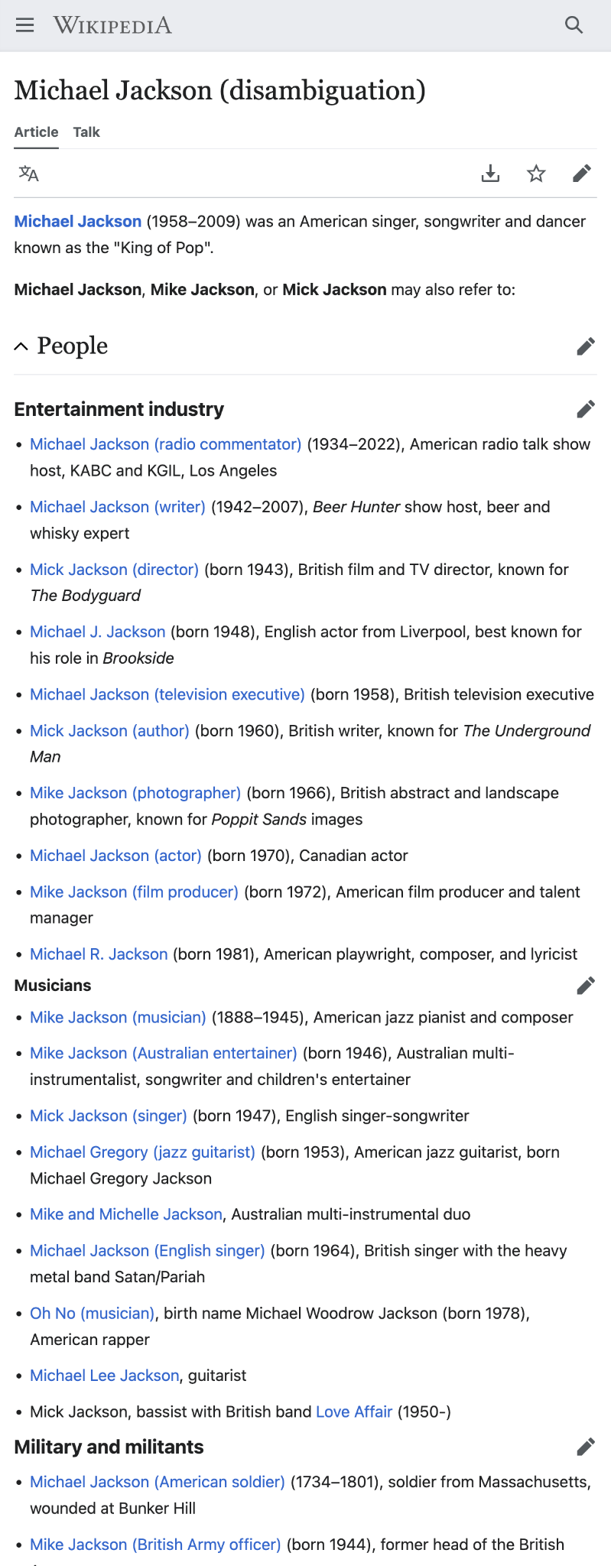
Detecting mentions of people names
#12 Handling network data
#2 Handling data
#10+11 Handling text data
Easy: unambiguous names
e.g., “Amy Winehouse”
Hard: ambiguous names
e.g., “Michael Jackson”
The city of Gary is known as the birthplace of singer Michael Jackson.
Wikipedia-based solution:
Given: a name X (e.g., “Michael Jackson”)
Consider all N links in English Wikipedia with X as anchor text (cf. examples on the right)
Build distribution over the N link targets
If there is a target T to which ≥90% of all links point: consider X “sufficiently unambiguous” and assume that all mentions of X in Spinn3r refer to T
Else: consider X “too ambiguous” and ignore it in the analysis
The city of Gary is known as the birthplace of singer Michael Jackson.
The city of Gary is known as the birthplace of singer Michael Jackson.
The city of Gary is known as the birthplace of singer Michael Jackson.
Beer and whisky expert Michael Jackson was born in Leeds.
…
Notes:
#2 WP as a data source (GG bridge)
#10+11 similar to method for detecting meaningful n-grams

Slide 14

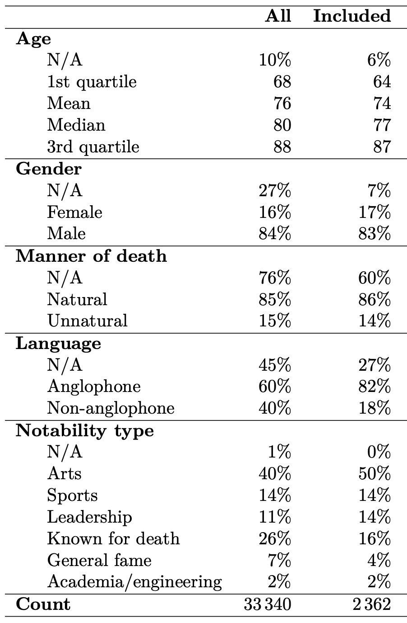
Recruiting the army of the dead:
Freebase, a once-popular knowledge graph
Now defunct, but still available
Contains information about >3M people
e.g., Philip Seymour Hoffman = /m/02qgqt
More info about some, less about others
Start from 33K people with death date 2009–2014
Further filtering → 2,362 people
Extract biographic information from Freebase
#12 Handling network data
#2 Handling data
Notes:
#2 intro’d Freebase (data stored as network model)
#12 a large network

Slide 15

Tools used
#13 Scaling to
massive data
Counting names in Spinn3r dump: Hadoop (Java)
Extracting info from Freebase: Python, Perl
Once data was small enough: R (script, repo)
Statistical analyses
Plotting
Read data as CSV once (minutes), then serialized to binary format and deserialized in later runs (seconds)
#2 Handling data

Slide 16
Intrat: Mention time series (our protagonist)
t: relative time t, counting days since death
t = 0: day of death
S_{i}(t): fraction of documents in which person i was mentioned, out of all documents published on day t
For mention time series, consider logarithms: log₁₀ S_{i}(t)
#1–13 ADA loves logs!

Slide 17
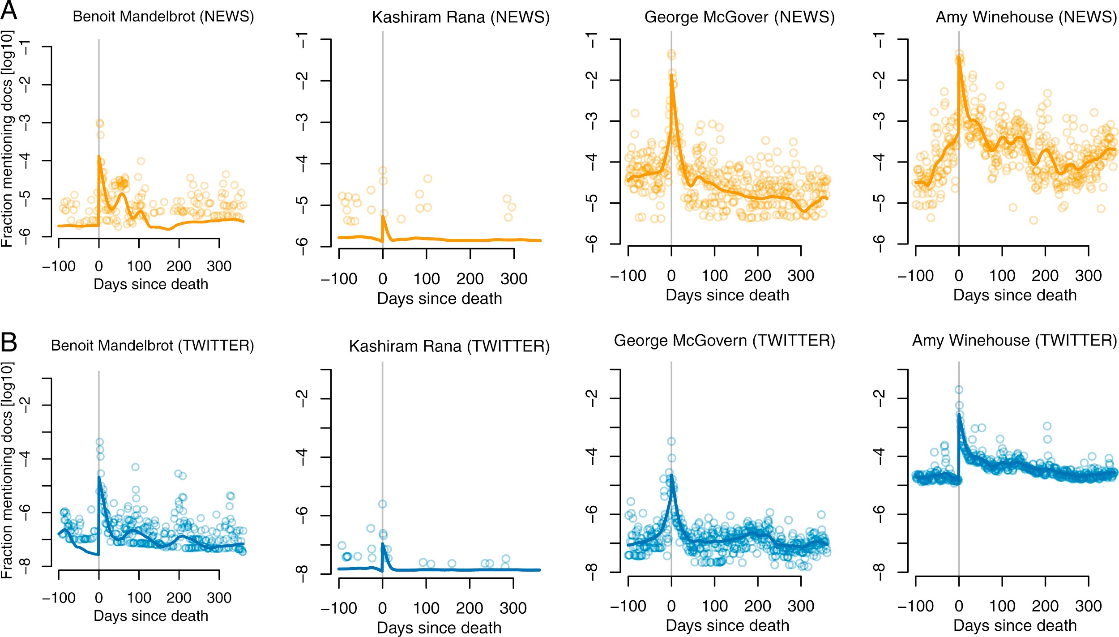
Mention time series: examples
#3 Visualizing data
News
Smoothed via “Friedman’s
super smoother”
Twitter
Notes:
#3 Small multiples
Same axes
#3 Why log?
Can show all OOMs
#3 Make data explicit (dots)

Slide 18
Part 2:
The shape of postmortem memory

Slide 19
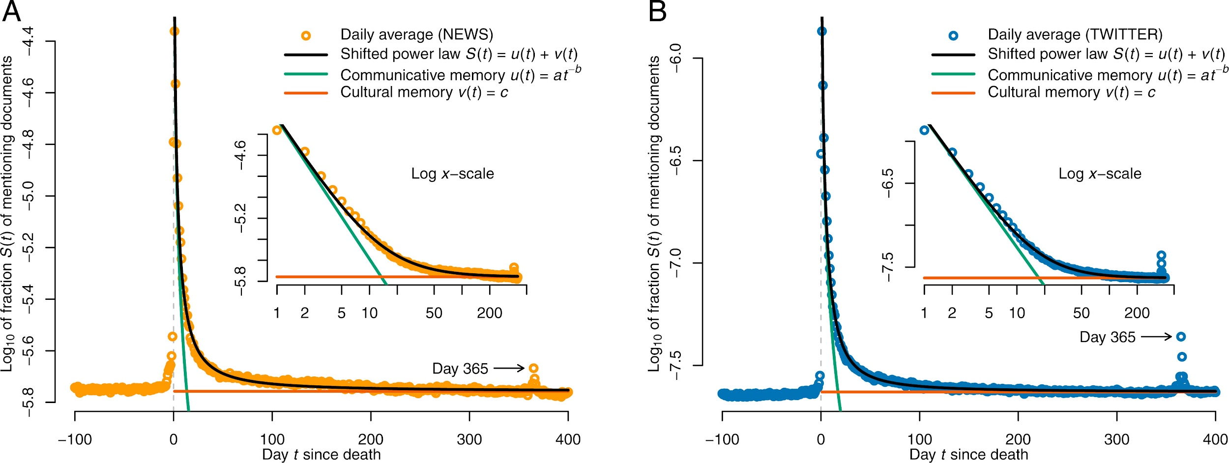
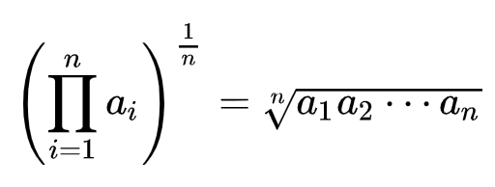
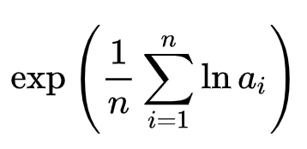
Average mention time series
News
#4 Describing data
Notes:
News (Twitter looks the same)
Ignore the lines for now, focus on the orange points
Look how step, even w/ log y! (w/o log, couldn’t see anything)
#4 y-axis has arithmetic mean of log mention freq == log geom mean of non-log mention freq
Geom mean better suited b/c it mitigates effect of outliers

Slide 20
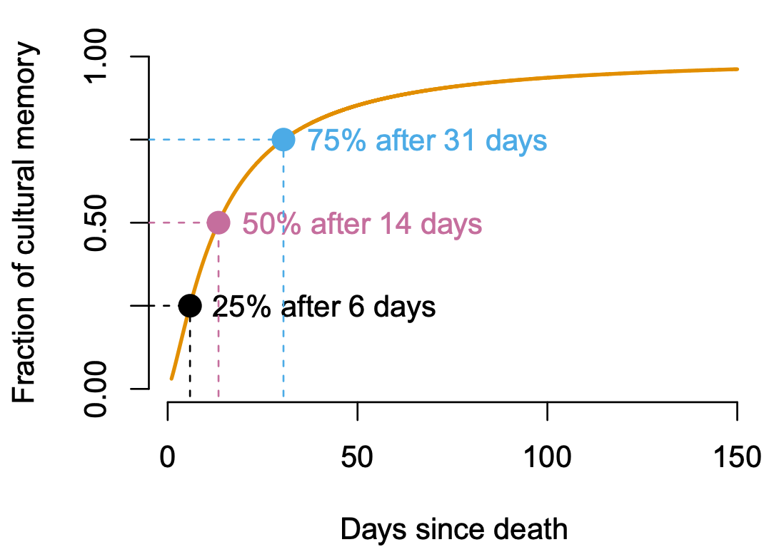
Modeling the data
Inflection point after about 1 month:
→ short vs. long term
#3 Visualizing data
y(t) = v(t)/(u(t) + v(t))
Notes:
What function describes the orange data?
Black line is a pretty good fit – what fct is it?
Black = power law + const
In linear space before log transform, i.e., really: exp(Black) = exp(power law + const)
To see it better, on what axes should we look at the plot (now it’s lin x, log y)?
[CLICK] #3 log-log
With c=0, it would be a power law (--> straight green line)
Cultural memory: “baseline” amount of mem built up during life time
Comm memory: quick burst that flares up with death, added to cult mem, on avg decays quickly
…
Inflection point after about 1 month

Slide 21
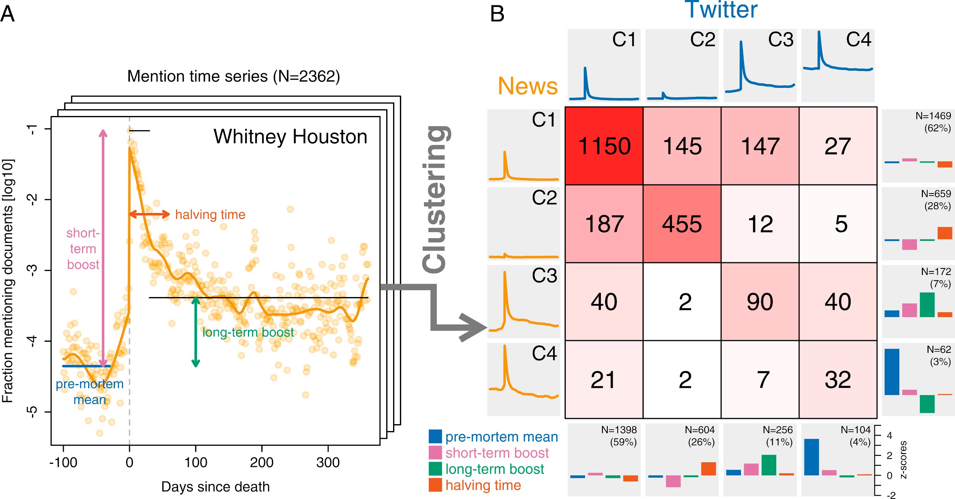
Curve characteristics
Pre-mortem mean: arithmetic mean of days 360 through 30 before death
Short-term boost: maximum of days 0 through 29 after death, minus the premortem mean
Long-term boost: arithmetic mean of days 30 through 360 after death, minus the premortem mean
Halving time: number of days required to accumulate half of the total area between the postmortem curve (including the day of death) and the minimum postmortem value
Median over people: 1.98 95% CI [1.90, 2.03]
Median over people: 0.00055 95% CI [-0.00091, 0.0017]
#4 Describing data
Notes:
Arith means after log transform == log of geom means before log transform
Very strong short-term boost: (non-log) geom mean: 10^1.98 ~= 100 → 100-fold increase
No signif long-term boost
Both are stronger on Twitter: 281-fold boost short-term, small but signif long-term (+4%)
#4 CIs, median

Slide 22
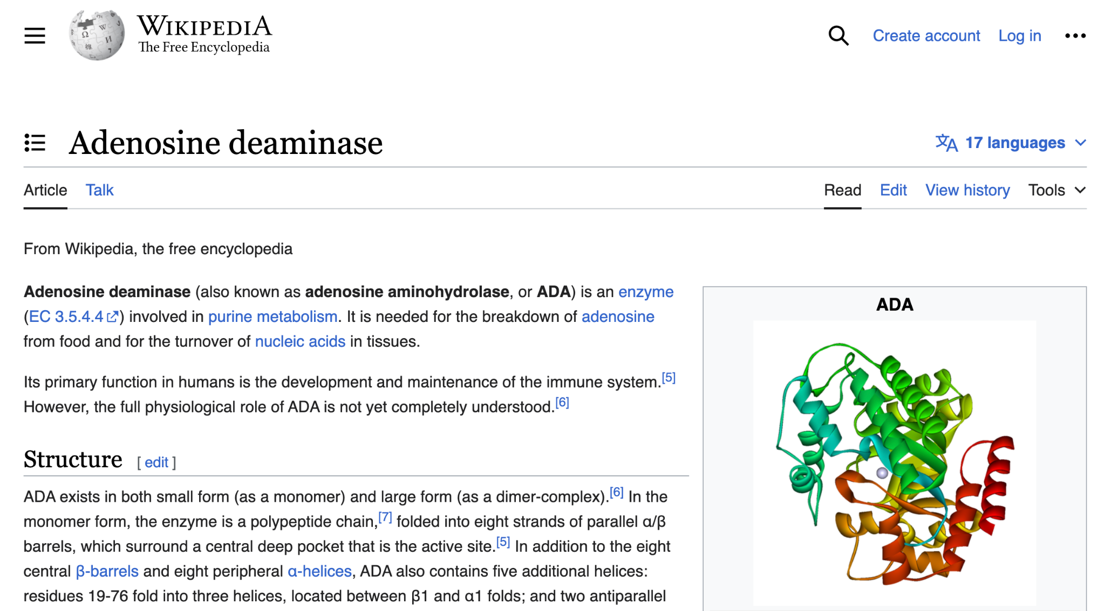
The Surgeon General warns:
Notes:
(Break slide)

Slide 23
Are there prototypical curve shapes?
Each curve one data point
Represented via its 4 curve characteristics
≈ manual dimensionality reduction
Values standardized via z-scores
Cluster via k-means
#8 Applied ML
#9 Unsupervised learning
Q: How to find the best number k of clusters?
Notes:
#9 Q: how to decide if there are prototypical curve shapes, and how to discover them?
#8 Q: what does “z-scores” mean?

Slide 24

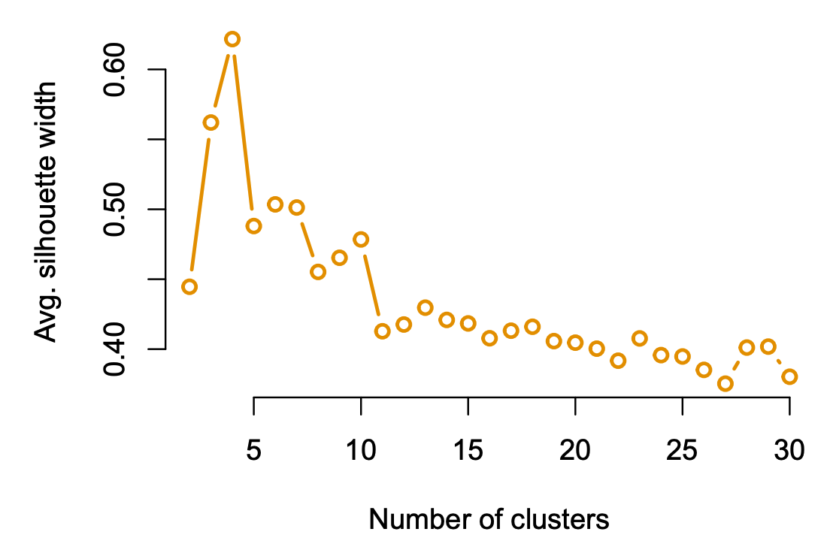
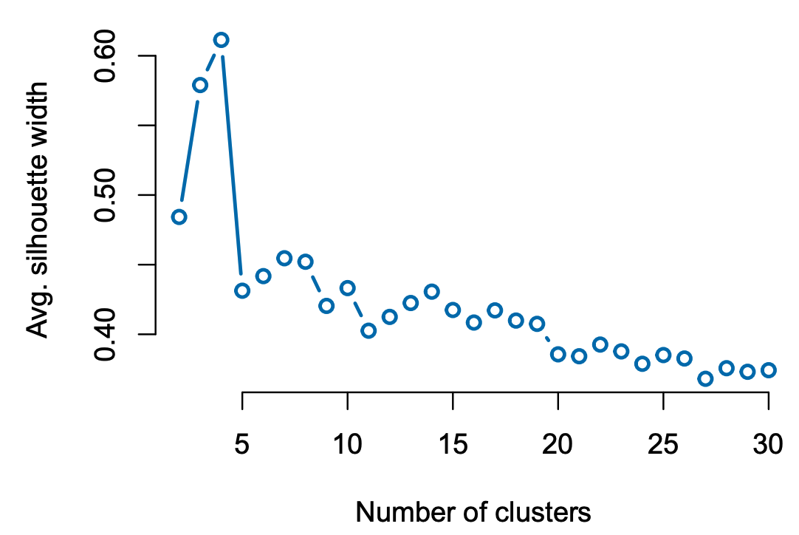
Average silhouette width!
#9 Unsupervised learning
News
Twitter
Notes:
What’s the best k?

Slide 25
Cluster analysis
“Blip”
“Silence”
“Rise”
“Decline”
#4 Describing data
Notes:
(This figure took me at least 2 days to make, in R)
Same set of clusters emerges (name and describe them!)
Roughly same size
Diagonal heavily overrepresented, compared to random null model w/ identical marginals
Q: one off-diag elem is overrep’d. Which one? (news C3, Twitter C4 [“40”] – not the “147”, which is large, but also in row w/ many elems)
#4 How to quantify? → hypo test

Slide 26
Part 3:
Biographic correlates of postmortem memory

Slide 27
A first stab
Measure correlation coefficient between outcome (e.g., short-term memory boost) and each biographic properties (e.g., gender)
Higher correlation ⇒ higher outcome for the respective group of people (e.g., women)
Notes:
…
Do you see any issues with this?

Slide 28
Problem: Biographic properties are correlated
E.g., leaders (politicians, CEOs, etc.) are
more likely to have died old,
more likely to have died of a natural death,
more likely to be men,
compared to artists
#5 Regression analysis
Regression analysis allows us to compare averages across subgroups of the data while accounting for correlations among averaged values!
Notes:
Q: how to disentangle these correlations?

Slide 29
Linear regression
Avg. outcome for “baseline persona”: male anglophone artist of median premortem popularity who died a natural death at age 70–79
Rank-transformed, then linearly scaled/shifted to [–0.5, 0.5]; i.e., median has value 0
y_{i} = β₀ + β₁ premortem_mention_freq_{i}
+ β₂ age_at_death_{i} + β₃ manner_of_death_{i} + β₄ notability_type_{i}
+ β₅ language_{i}
+ β₆ gender_{i}
Outcome for person i:
short-term boost or
long-term boost
8 discrete levels (dummy-coded): 20–29, 30–39, …, 70–79, 80–89, 90–99
2 levels: natural, unnatural
6 levels: arts, sports, leadership, known for death, general fame, academia/engineering
3 levels: anglophone, non-anglophone, unknown
2 levels: male, female
Notes:
Dummy-coding: k-1 indicators for a k-level factor (e.g., 7 indicators for age_at_death, since there are 8 age groups)
⇒ \beta_j are really vectors with k-1 entries for a k-level factor
Default values underlined (most freq level)
Outcome are (by def) base-10 logarithms of post-to-pre-mortem ratios
⇒ 10^\beta_0 is (geom mean of) postmortem-to-premortem ratio
10^\beta_j are multiplicative increases over the baseline ratio

Slide 30
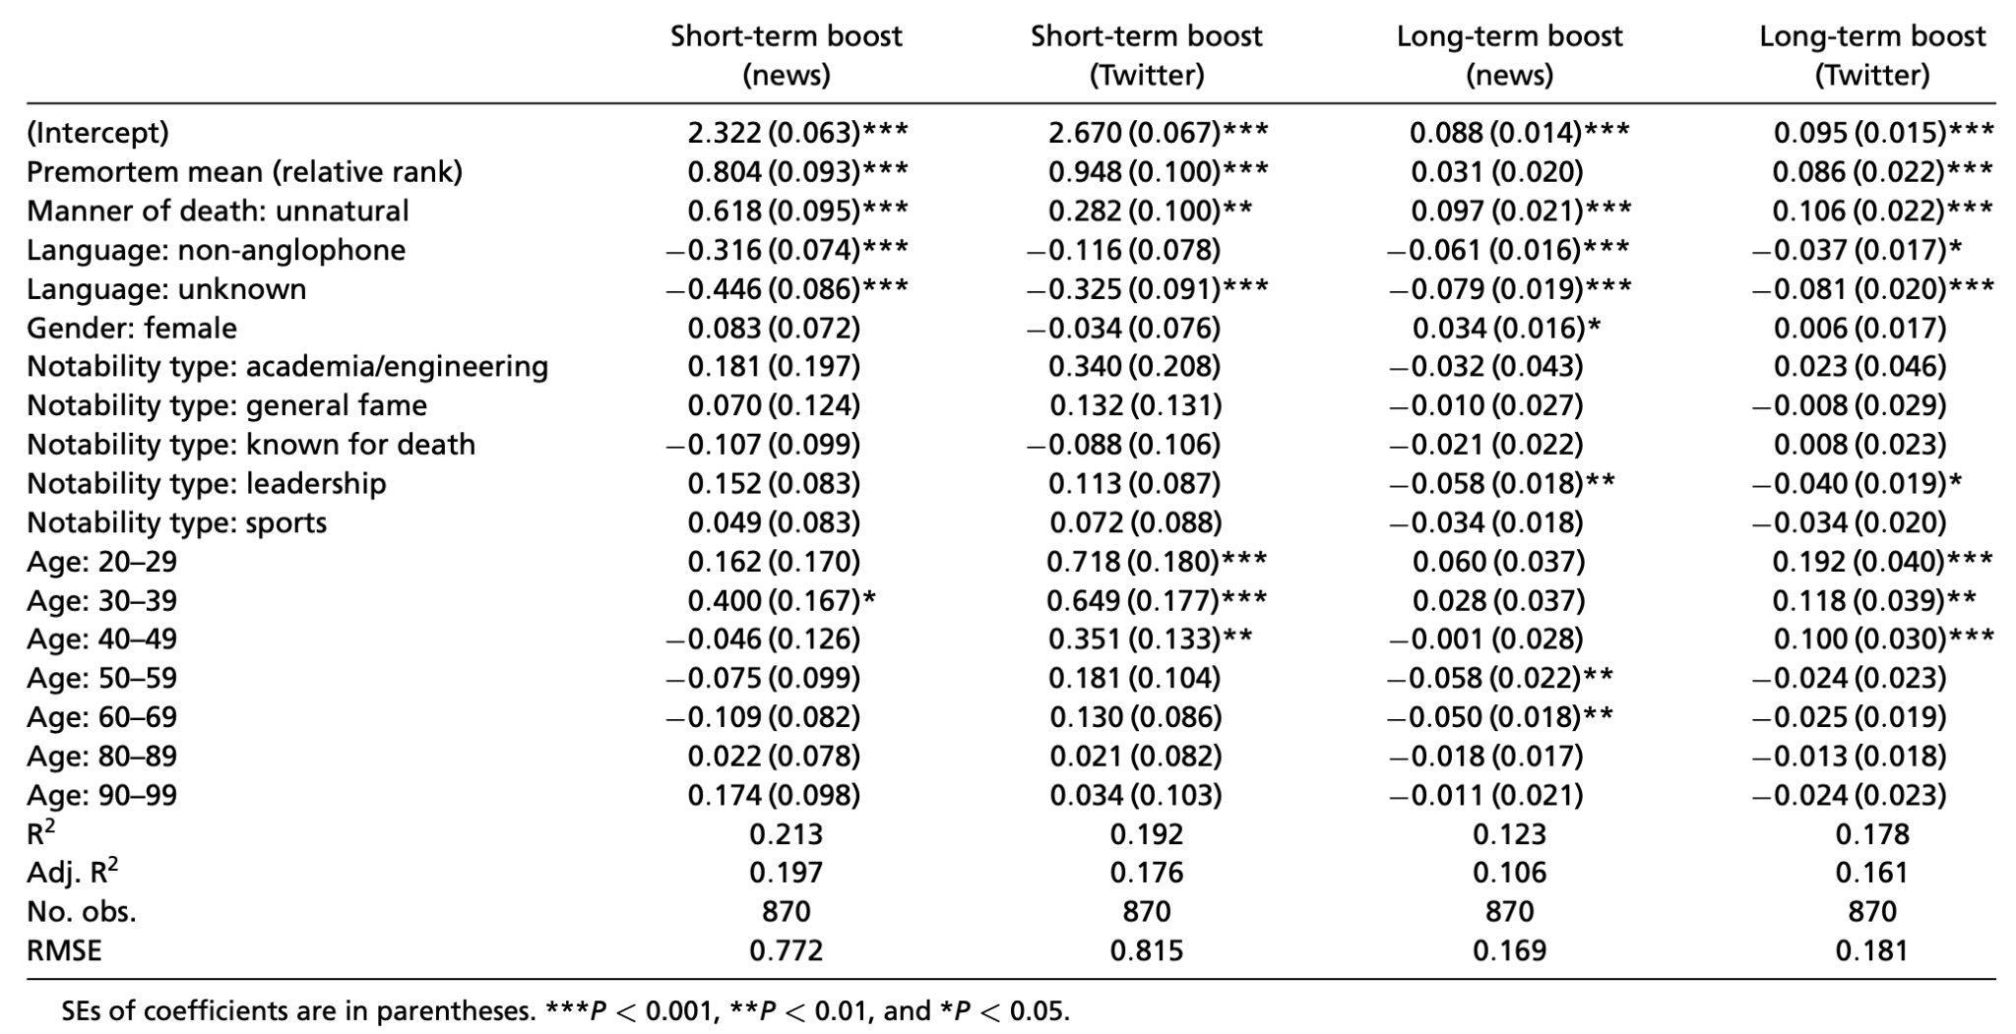
Linear regression results
Notes:
4 regressions: 2 media, 2 outcomes
largely consistent picture for the news vs. Twitter
in both media, ceteris paribus, both the short- and the long-term boost were larger for people
who died an unnatural death,
for people with an anglophone background,
and for people who were already popular premortem.
No significant gender variation was detected, with the one minor exception
The only significant notability type was leadership, whose long-term boost was smaller than that of the baseline (arts) in both media.
R^2 is small: 10–20% of variance explained
Common for such data from humans!

Slide 31
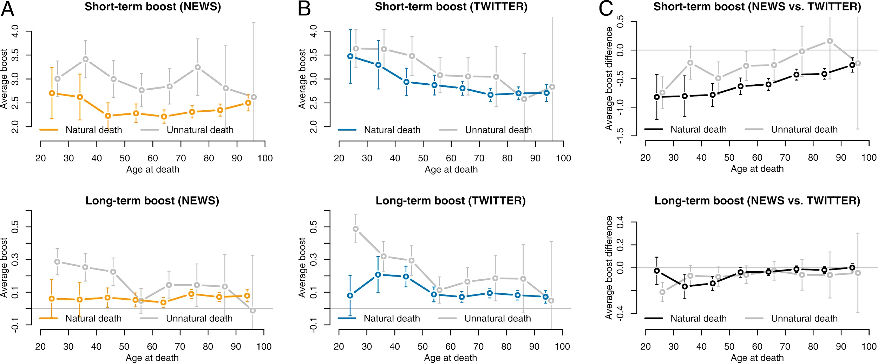
Age at death vs. postmortem memory
News plays two simultaneous roles (more so than Twitter):
Catering to public curiosity stirred by a young or unnatural death
But also when old person or accomplished leader dies
Notes:
Only showing short-term boosts here
Essentially a plot of age coeffs from table on prev slide
But one twist: pull apart nat & unnat deaths
Q: how?
A: add interaction term “age * manner_of_death”
U-shape: very young and very old deaths get largest attention boosts
This was for the news, now Twitter [CLICK]
Monotonic instead of U-shape!
Younger deaths get largest attention boosts
RHS: CIs for same age always overlapping strongly ⇒ no significance?
It *is* signif when you aggregate over ages (more data), cf. table on prev slide

Slide 32
Part 4:
Discussion

Slide 33
Summary: The shape of postmortem memory
Sharp pulse of media attention with death:
Median: +9,400% in news, +28,000% on Twitter
Then sharp drop (around 1 month long) toward premortem level
Two components of collective memory:
Baseline level of cultural memory built up during life (constant)
Added layer of communicative memory sparked by death (power law)
Cluster analysis revealed a set of four prototypical memory patterns: “Blip”, “silence”, “rise”, “decline”
Same patterns in news and Twitter; same person tends to fall into the same cluster across the two media

Slide 34
Summary: Biographic correlates
Notability types: all regression coefficients for long-term boosts negative ⇒ All types have lower average long-term boost than default type (artists) ⇒ Artists more present in collective memory
Low R² (10–20%): human lives/legacies rich, hard to model
But all model fits highly significant (F-statistic, p-value)
Effects not only significant, but also large: e.g., short-term boost (on linear scale) for unnatural vs. natural death: 4x in news, 2x on Twitter
Largest boost:
Premortem popular anglophones who died a young, unnatural death
Long-term boosts largest for artists, smallest for leaders
Notes:
Artists more present in collective memory because they not only tend to be active performers during their lifetime, but also frequently leave a legacy of artwork that can long survive them, whereas leaders, athletes, etc., are noteworthy primarily for the actions they take during their lifetime, and are of much decreased interest to the media once they cannot take action anymore—an effect that seems to be most pronounced for leaders (most negative coeff)
Pro tip: Become a famous artist fast, die an unnatural death, now (bonus if you’re a native English speaker)

Slide 35


Merry Christmas ADA happy New Year!

